Slide 1








Investment Portfolio Optimisation using LP and ILP Models
MIS775: Desion Modeling for Business Analytics
Name: Duong Ngoc Phuong Trang
Student ID: 223990468
04

Slide 2







TABLE OF CONTENTS
Section 1: PRELIMINARY WORK
Introduction
Stock (asset) selection
The risk group classifications
Section 3: ILP OPTIMISATION MODELS
3 ILP model
Algebraic formulation
Optimal solution and the relevant worksheet/output sheet of the model
Interpretation and suggestions
Section 2: LP OPTIMISATION MODELS
2 LP model
Conceptual diagram & Algebraic formulation
Optimal solution & the relevant worksheet/output sheet of the model
Sensitivity report
Suggestions
Section 4: OPTIMISATION RESULTS AND RECOMMENDED STRATEGY
Summary table of results for all models
Preferred strategy & Rationale

Slide 3
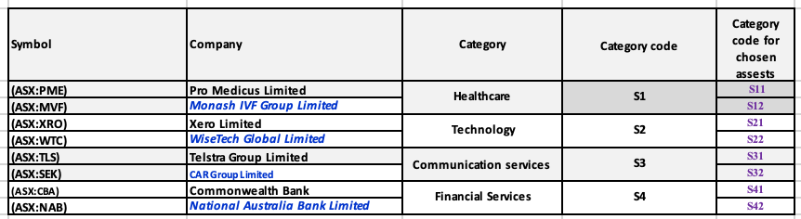
SECTION 1: PRELIMINARY WORK
Introduction
This analysis aims to evaluate the monthly returns and risk levels of eight stocks listed on the Australian Stock Exchange (ASX) over a 48-month period from January 2021 to January 2025. Data is collected from Listcorp. via the STOCKHISTORY function in Excel, with a monthly frequency, providing the closing price as the basis for calculating the returns.
From the data series obtained, monthly returns are calculated based on the price fluctuations between two consecutive months. Then, stocks are classified by risk level based on the volatility of yields - reflecting the profitability and stability of each asset. Thereby, the analysis supports the construction of effective investment strategies, suitable for each investor's risk tolerance.
The eight stocks were purposefully selected to represent four major sectors of the Australian economy: healthcare, technology, communications, and financial services. Each sector is represented by two ASX-listed companies, such as
Healthcare: Pro Medicus Limited (ASX:PME) & Monash IVF Group (ASX:MVF);
Technology: Xero Limited (ASX:XRO) & WiseTech Global (ASX:WTC);
Communication services: Telstra Group (ASX:TLS) and CAR Group (ASX:SEK);
Financial services: Commonwealth Bank (ASX:CBA) and National Australia Bank (ASX:NAB).

Slide 4
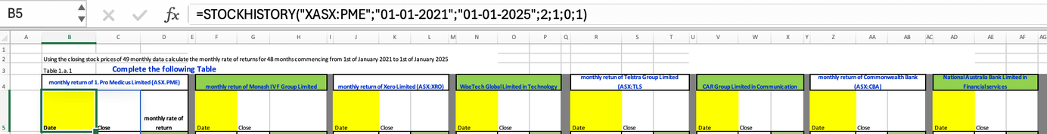
SECTION 1: PRELIMINARY WORK
Stock (asset) selection
The reason for selecting these stocks comes from the desire to build a diversified portfolio by sector, helping to evaluate the performance and risk in many different areas. In addition, these companies are all large and liquid, and have a stable operating history, helping to ensure that the collected data is complete and continuous for 49 months (from January 2021 to January 2025).
Stock price data is collected from Listcorp. using the STOCKHISTORY function in Excel. For example, the formula allows to retrieve monthly closing prices during the study period:
=STOCKHISTORY("ASX:PME", "01-01-2021", "01-01-2025", 2, 1, 0)
The parameters in this formula have been set correctly:
Data collection period: from 01/01/2021 to 01/01/2025 (49 data points)
Frequency: monthly (parameter = 2)
Metric used: closing price
Data is displayed with clear titles.
Following the data collection, the dataset is systematically processed to compute the monthly rates of return using the standard financial formula, which measures the percentage change in closing prices between two consecutive months.
Rate of Returnt​ = [Pt−​P(t-1)​/P(t−1)]​​×100%
This formula is applied to all 8 stocks. The resulting returns are fully presented in the “monthly rate of return” column, which facilitates quantitative analysis for the next step: assessing risk and performance.

Slide 5
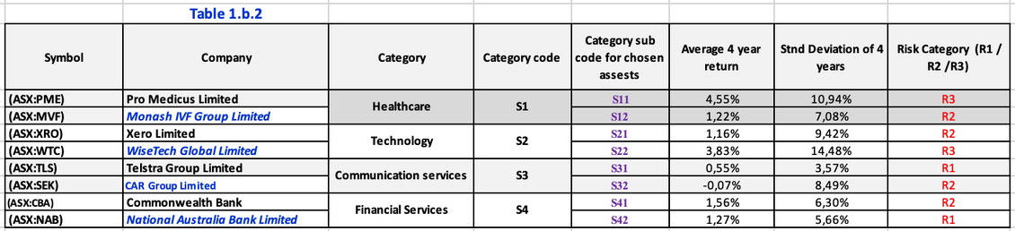
SECTION 1: PRELIMINARY WORK
The risk group classifications
The risk classification shown in Table 1.b.2 is based on two key financial metrics:
Average 4-year return – representing the long-term performance of the asset.
Standard deviation over 4 years – measuring the volatility or risk level of the asset.
Assets are divided into three risk categories:
R1 (Low Risk) – stable assets with low volatility (<6%)
R2 (Medium Risk) – moderately volatile assets with balanced return-risk profiles. (6%<x<10%)
R3 (High Risk) – highly volatile assets with greater return potential but increased risk (>10%)
R1 Group – Low Risk
This group includes:
Telstra Group Limited (ASX:TLS)
→ Avg. return: 0.55%, Std. deviation: 3.57%
National Australia Bank (ASX:NAB)
→ Avg. return: 1.27%, Std. deviation: 5.66%
Both companies show the lowest volatility in the dataset, with standard deviations below 6%. This indicates that their prices are relatively stable, with limited market sensitivity. Telstra, operating in the telecommunications sector, enjoys steady revenues. NAB, a major banking institution, operates in a heavily regulated environment, with predictable income streams from interest and service fees.
→ This group suits conservative investors who prioritise capital preservation over aggressive growth.
R3 Group – High Risk
This category includes:
Pro Medicus Limited (ASX:PME)
→ Return: 4.55%, Std. deviation: 10.94%
WiseTech Global (ASX:WTC)
→ Return: 3.83%, Std. deviation: 14.48%
These stocks offer the highest returns in the dataset but also exhibit the greatest volatility. PME, a healthcare technology company, shows strong growth potential but depends on R&D investment and global demand for medical software. WTC, a logistics tech firm, is influenced by global supply chains and investor expectations, making its price movements more unpredictable.
For example, WTC’s standard deviation of 14.48% – the highest among all – highlights that its monthly returns often swing dramatically, reflecting both opportunities and risks.
→ This group is suitable for aggressive investors who seek higher gains and are willing to accept significant volatility.

Slide 6
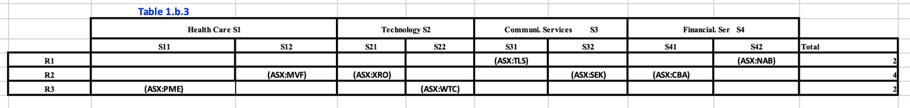
SECTION 1: PRELIMINARY WORK
The risk group classifications
R2 Group – Medium Risk
This group includes:
Monash IVF Group (ASX:MVF)
→ Return: 1.22%, Std. deviation: 7.08%
Xero Limited (ASX:XRO)
→ Return: 1.16%, Std. deviation: 9.42%
CAR Group Limited (ASX:SEK)
→ Return: -0.07%, Std. deviation: 8.49%
Commonwealth Bank (ASX:CBA)
→ Return: 1.56%, Std. deviation: 6.30%
This group demonstrates a balanced trade-off between returns and risk. For example, Xero offers attractive returns but also has relatively higher volatility, as expected from a technology company that is sensitive to investor sentiment and innovation cycles. CBA shows slightly lower volatility than NAB but still fits within the medium-risk range.
CAR Group is noteworthy: although it recorded a negative average return (-0.07%), its standard deviation is moderately high at 8.49% – suggesting price fluctuations without consistent upward movement, which may result from operational challenges or negative market perceptions.
→ This group is ideal for balanced investors who can tolerate moderate risk for the opportunity to achieve moderate returns.
Overall, Table 1.b.3 shows a well-balanced portfolio allocation. Risk category R2 accounts for 50%, indicating that most stocks have moderate risk. The portfolio also maintains diversity with 25% in high-risk and 25% in low-risk assets, catering to different investor risk appetites.
The Financial Services sector (S4) shows the lowest risk, with one stock in R1 (NAB) and one in R2 (CBA), and none in R3.
The Technology sector (S2) has the highest risk, with one stock in R2 and one in R3, which aligns with market characteristics.
The Healthcare sector (S1) shows risk variation—PME in R3 and MVF in R2—possibly reflecting differences in business models, as PME is more technology-driven than MVF.

Slide 7
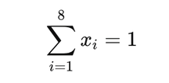





SECTION 2: LP OPTIMISATION MODELS
Conceptual diagram & Algebraic formulation
This section presents a Linear Programming (LP) model developed to optimise asset allocation across 8 stocks. The goal is to maximise the expected return while satisfying constraints related to risk categories (R1–R3) and sector diversification (S1–S4). Assuming each decision variable S1-4​ represents the percentage of investment in a stock.
Objective Function:
The goal is to maximise the expected return of the portfolio based on the average 4-year returns of the individual assets. The objective function is defined as:
Total Z= 4.55%S11 + 1.22%S12 + 1.16%S21 + 3.83%S22 + 0.55%S31 + (-0.07%)S32 + 1.56%S41 + 1.27%S42
Where:
S1-4​: represent the proportion of funds allocated to PME, MVF, XRO, WTC, TLS, SEK, CBA, and NAB respectively.
The coefficients represent the average 4-year monthly returns of each asset.
The model includes several constraints based on realistic investment principles:
Total investment must equal 100%:
4. The low-risk group (R1) must have the highest total allocation among all risk groups:
2. Total investment in high-risk assets (R3) must not exceed 15%
5. Each individual stock must have a minimum of 5% and a maximum of 20% allocation:
3. Total investment in medium-risk assets (R2) must not exceed 30%:
6. Each sector must receive at least 15% total allocation:

Slide 8
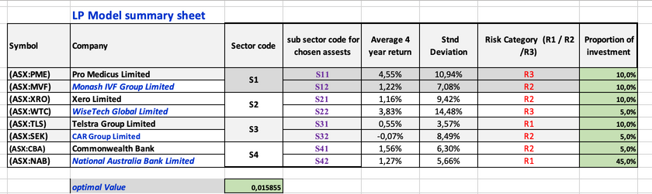
SECTION 2: LP OPTIMISATION MODELS
The optimal solution & the relevant worksheet/output sheet of the model
Based on the Solver’s output under the “Variable Cells” section, the LP model determines the following optimal investment weights for each asset:
In the optimal solution, the portfolio allocates:
55% to low-risk assets (R1) → This satisfies the constraint requiring the lowest-risk category to dominate.
30% to medium-risk assets (R2) → This is within the allowable limit of 30%.
15% to high-risk assets (R3) → This allocation reaches the upper limit imposed on high-risk investments.
Despite Pro Medicus (PME) offering the highest average 4-year return at 4.55%, it is only allocated 10% of the portfolio. In contrast, National Australia Bank (NAB), with a relatively modest return of 1.27%, is allocated 45% – the largest single allocation in the entire portfolio.
Similarly, WiseTech Global (WTC), a high-risk technology stock with a strong return of 3.83%, is limited to just 5%, the minimum allowable investment per asset.
The optimal solution of 1.5855% is considered reasonable. This level of return reflects a portfolio constructed under a defensive investment strategy, which prioritizes stability and safety over taking risks to achieve higher returns. However, this cautious approach is also the main reason why the optimal return is not significantly high.
These allocation choices reflect the LP model's priority on risk mitigation over return maximisation. The model was designed with multiple risk-related constraints, particularly:
A cap on high-risk asset exposure (R3 ≤ 15%)
A requirement for the lowest-risk category (R1) to hold the largest total allocation
As a result, higher-return assets such as PME and WTC, which fall into the high-risk group, are constrained by their risk category, even though they could potentially increase the overall portfolio return.
On the other hand, low-risk assets like NAB, despite lower returns, receive heavier weights to ensure compliance with safety-focused constraints.

Slide 9
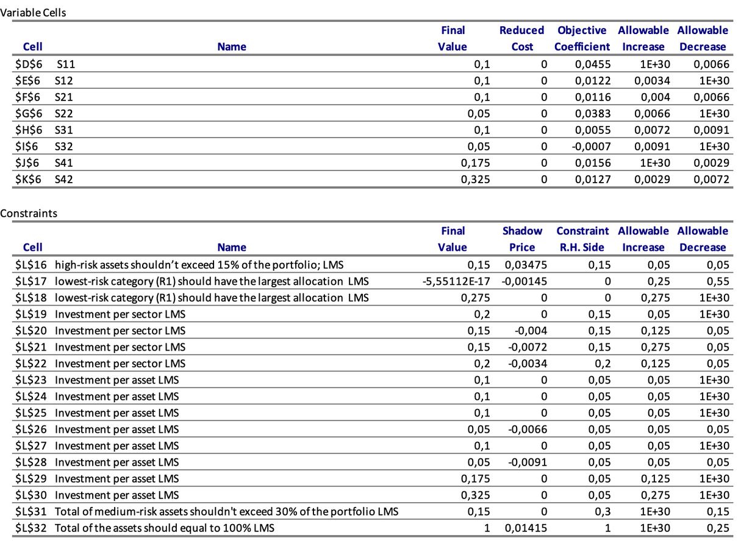
SECTION 2: LP OPTIMISATION MODELS
Sensitivity report
Binding Constraints That Limit Optimisation
High-risk assets should not exceed 15% of the portfolio
Final Value: 0.15 (equal to limit)
Shadow Price: 0.03475
Allowable Increase/Decrease: 0.05
Interpretation:
→ This is the most critical constraint in the model, as it directly limits investment in high-return stocks like PME and WTC (classified as R3). A shadow price of 0.03475 indicates that increasing this threshold by 1% would raise the total portfolio return by 3.475%.
Lowest-risk group (R1) should have the largest allocation
Final Value ≈ 0 → considered binding
Shadow Price: –0.00145
Allowable Increase: 0.25 | Decrease: 0.55
Interpretation:
→ This constraint forces R1 (NAB and TLS) to have the largest allocation. A negative shadow price shows that this rule slightly reduces the maximum return the portfolio can achieve.
Medium-risk assets should not exceed 30%
Final Value: 0.15
Shadow Price: 0
Interpretation:
Currently, the total investment in medium-risk assets is only 15%, well below the limit. Hence, this constraint does not restrict the model at this point.

Slide 10
SECTION 2: LP OPTIMISATION MODELS
Sensitivity report
Analysis of Decision Variables (Variable Sensitivity)
All decision variables have reduced cost = 0, confirming that all assets are active in the optimal solution.
PME (S11) – Highest return (4.55%)
→ Very sensitive; allowable decrease = 0.0066 → A slight drop in return would exclude it from the portfolio.
WTC (S22) – High-return stock
→ Allowable increase = 0.0066 → If return slightly decreases, it may no longer be optimal.
NAB (S42) – Largest allocation (32.5%)
→ Allowable decrease = 0.0072 → Needs consistent performance to justify its large weight.
MVF (S12) & XRO (S21)
→ Small allowable increases (0.0034 and 0.004) → Already near optimal level; performance improvements would not change their inclusion significantly.
This sensitivity analysis reveals that while all assets are currently part of the optimal allocation, certain assets like PME, WTC, and NAB are critical drivers of the portfolio’s return. Their inclusion is highly dependent on maintaining current return levels. Any slight fluctuation in these returns could reshape the portfolio, indicating a need for close performance monitoring and regular re-optimisation. Meanwhile, assets like MVF and XRO are stable components, less likely to be affected by minor changes.

Slide 11
SECTION 2: LP OPTIMISATION MODELS
Sensitivity report
Suggestion
To further enhance portfolio performance, it is recommended to increase the upper limit on high-risk assets (R3) from 15% to 20%, as the current shadow price (0.03475) suggests this constraint is significantly limiting returns. Relaxing this constraint would allow more capital allocation to high-return stocks like PME and WTC, potentially boosting the overall expected return.
Additionally, the constraint requiring the lowest-risk group (R1) to have the highest allocation could be reconsidered. While it ensures safety, it also slightly reduces profitability (as indicated by its negative shadow price). For investors with moderate risk tolerance, removing or softening this rule may strike a better balance between risk and return.
Finally, given the high sensitivity of key assets like PME, WTC, and NAB, it is advisable to regularly re-optimise the model in response to market changes to maintain an efficient and robust portfolio.

Slide 12


SECTION 3: LP OPTIMISATION MODELS
Algebraic formulation
This Integer Linear Programming (ILP) model aims to maximise the expected return of a portfolio subject to strict investment rules. The decision variables S1-4 are binary (0 or 1)
Objective function (maximise expected return):
Maximise Z= 4.55%S11 + 1.22%S12 + 1.16%S21 + 3.83%S22 + 0.55%S31 + (-0.07%)S32 + 1.56%S41 + 1.27%S42
The model includes several constraints based on realistic investment principles:
1.Exactly 5 assets selected:
4. At least 2 assets from lowest-risk group (R1):
2. Include at least 4 sectors:
5. Select R3 only if at least 1 R2 is selected:
3. At most 1 asset in the highest-risk group (R3):
6. Asset from R2 with high return and low risk (CBA) must be included:

Slide 13
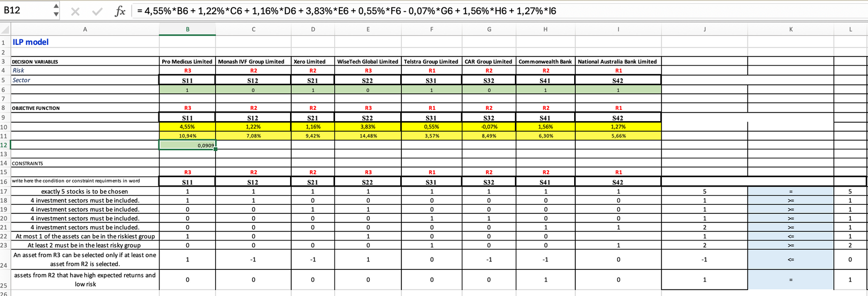
SECTION 3: LP OPTIMISATION MODELS
Optimal solution and the relevant worksheet/output sheet of the model
Based on the output worksheet:
The 5 selected assets are:
Pro Medicus Limited (PME) – R3
Xero Limited (XRO) – R2
Telstra (TLS) – R1
Commonwealth Bank (CBA) – R2
NAB – R1
The objective return calculated from selected assets:
Z=0.0455+0.0116+0.0055+0.0156+0.0127=9.09%
→ The model is visually and logically well-organised in the worksheet, with binary variable matrix, risk group tagging, sector tagging, and calculated Z displayed clearly.
All key constraints are satisfied, including:
Sector coverage: S1, S2, S3, S4 included
Exactly 1 high-risk asset (PME)
At least 2 low-risk assets (TLS, NAB)
CBA (R2 asset with low risk, high return) is selected

Slide 14
SECTION 3: LP OPTIMISATION MODELS
Interpretation & Suggestion
Interpretation:
The ILP model successfully selected a portfolio of five assets—PME, XRO, TLS, CBA, and NAB—which satisfy all given constraints while achieving a strong expected return of 9.09%.
The inclusion of PME (R3) is justified by its high return (4.55%) and is supported by two low-risk assets (TLS and NAB) to maintain overall portfolio stability. This satisfies both the “at most 1 R3” and “at least 2 R1” constraints.
CBA (R2) was strategically selected due to its favourable balance of return and low risk, fulfilling the condition that a high-performing R2 asset must be included. The model also ensures sector diversification, as all four sectors (S1–S4) are represented.
Overall, the model demonstrates an effective balance between risk management and return maximisation, reflecting a realistic and disciplined investment strategy under strict selection rules.
Suggestions:
If risk tolerance allows, consider relaxing the “at most 1 R3” constraint to allow both PME and WTC – this may further increase expected return.
Explore dynamic sector requirements in future versions (e.g., weighting sectors by market cap or growth).
Run sensitivity tests by removing each selected asset and recalculating Z to assess portfolio stability and critical dependencies.

Slide 15
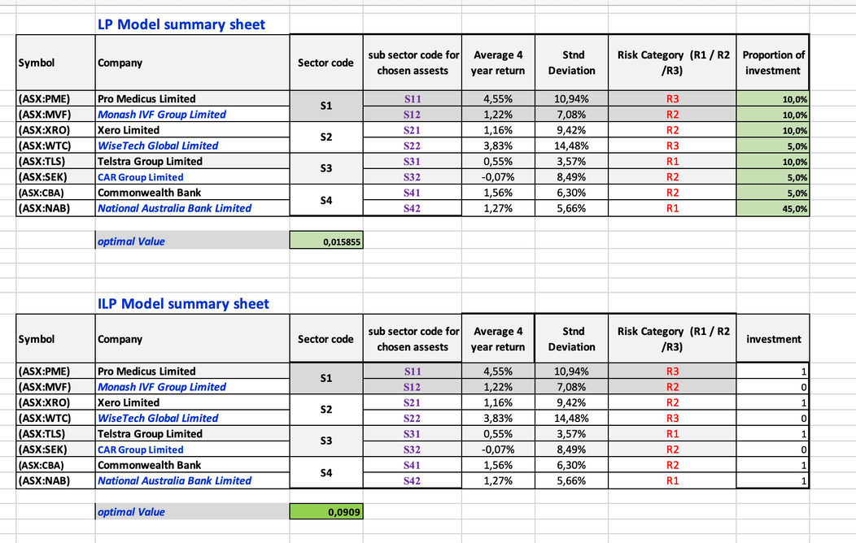
SECTION 4: OPTIMISATION RESULTS
In the LP model, the portfolio allocates varying percentages to all 8 assets. Notably, NAB (R1) receives the highest allocation (45%), while high-risk assets such as PME and WTC are capped at 10% and 5%, respectively. This model reflects a cautious, diversified approach and adheres closely to risk thresholds.
In contrast, the ILP model selects only 5 assets based on binary constraints. It includes PME, TLS, CBA, NAB, and XRO, all of which collectively yield a much higher expected return of 9.09%. The model avoids lower-return assets like SEK or MVF and includes just one high-risk asset (PME), balanced by two low-risk assets (TLS and NAB).

Slide 16
SECTION 4: RECOMMENDED STRATEGY
Based on the comparison, the ILP model is the preferred strategy for this scenario. Although the LP model offers broader diversification and fractional risk spreading, its overall return (1.5855%) is relatively low and may not meet investor expectations in a moderately aggressive investment context.
The ILP model, while more restrictive in terms of asset inclusion, provides a clear performance advantage (9.09%). It effectively balances risk and return by:
Selecting only one high-risk asset (PME) with the highest return,
Ensuring diversification across all four sectors,
Including strong-performing low-risk and medium-risk stocks like NAB, TLS, and CBA.
This strategy is ideal for investors who seek higher returns while still maintaining reasonable risk control through discrete asset selection, sector spread, and strict constraints.

